Slide 1
Vacuum Cleaner

Slide 2
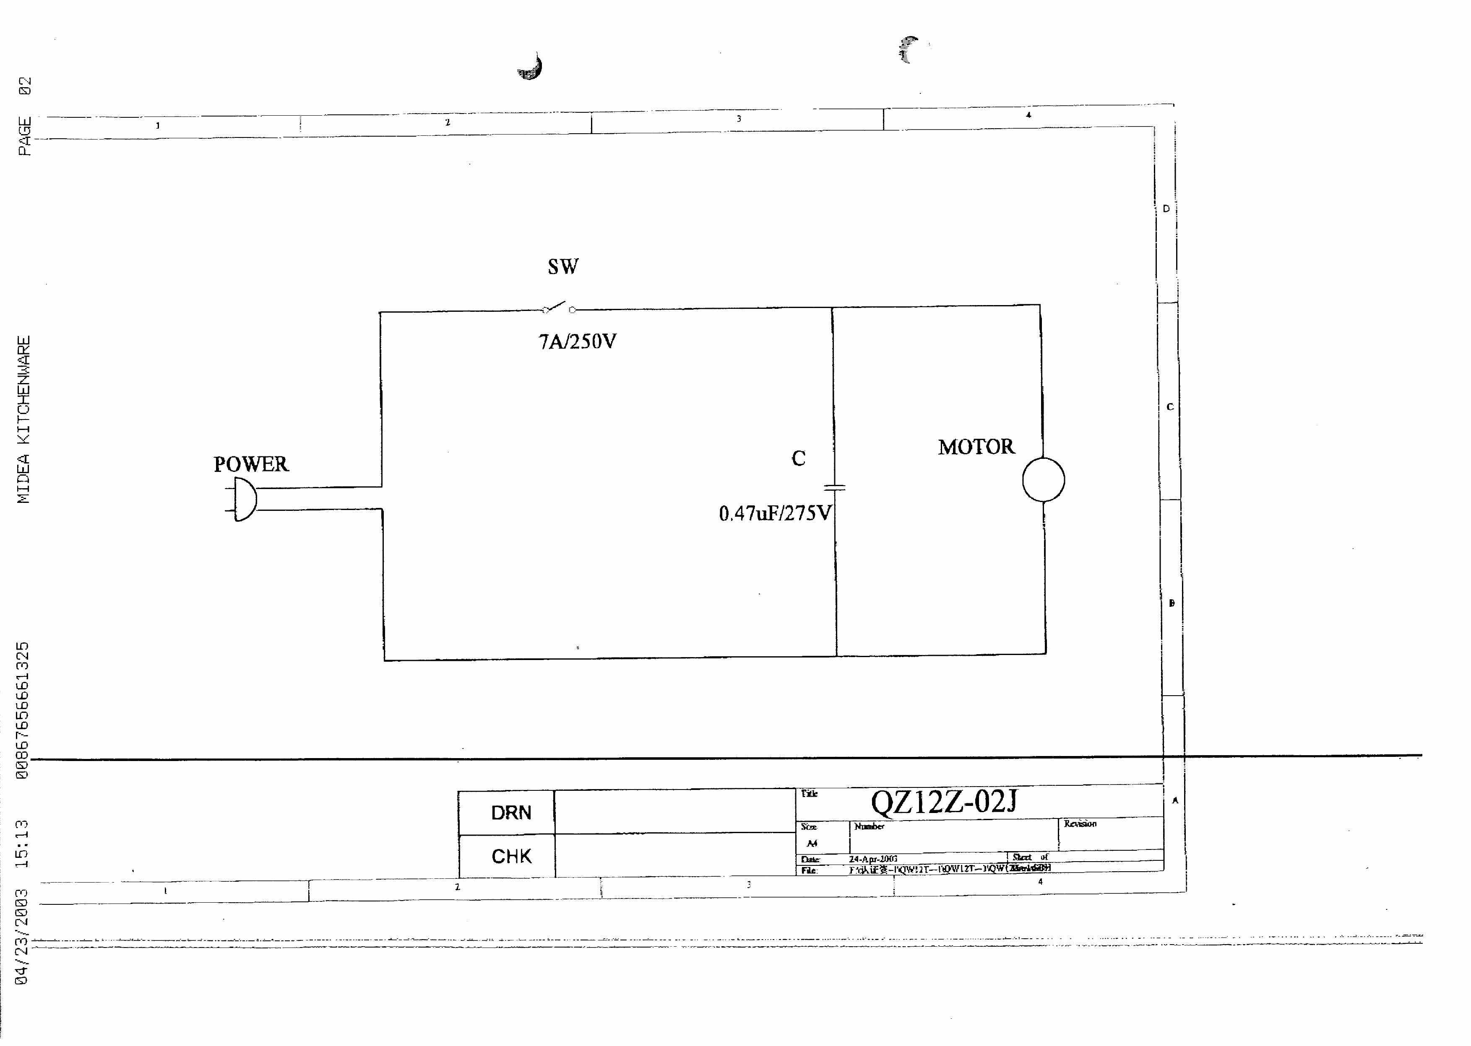
Circuit Diagram

Slide 3
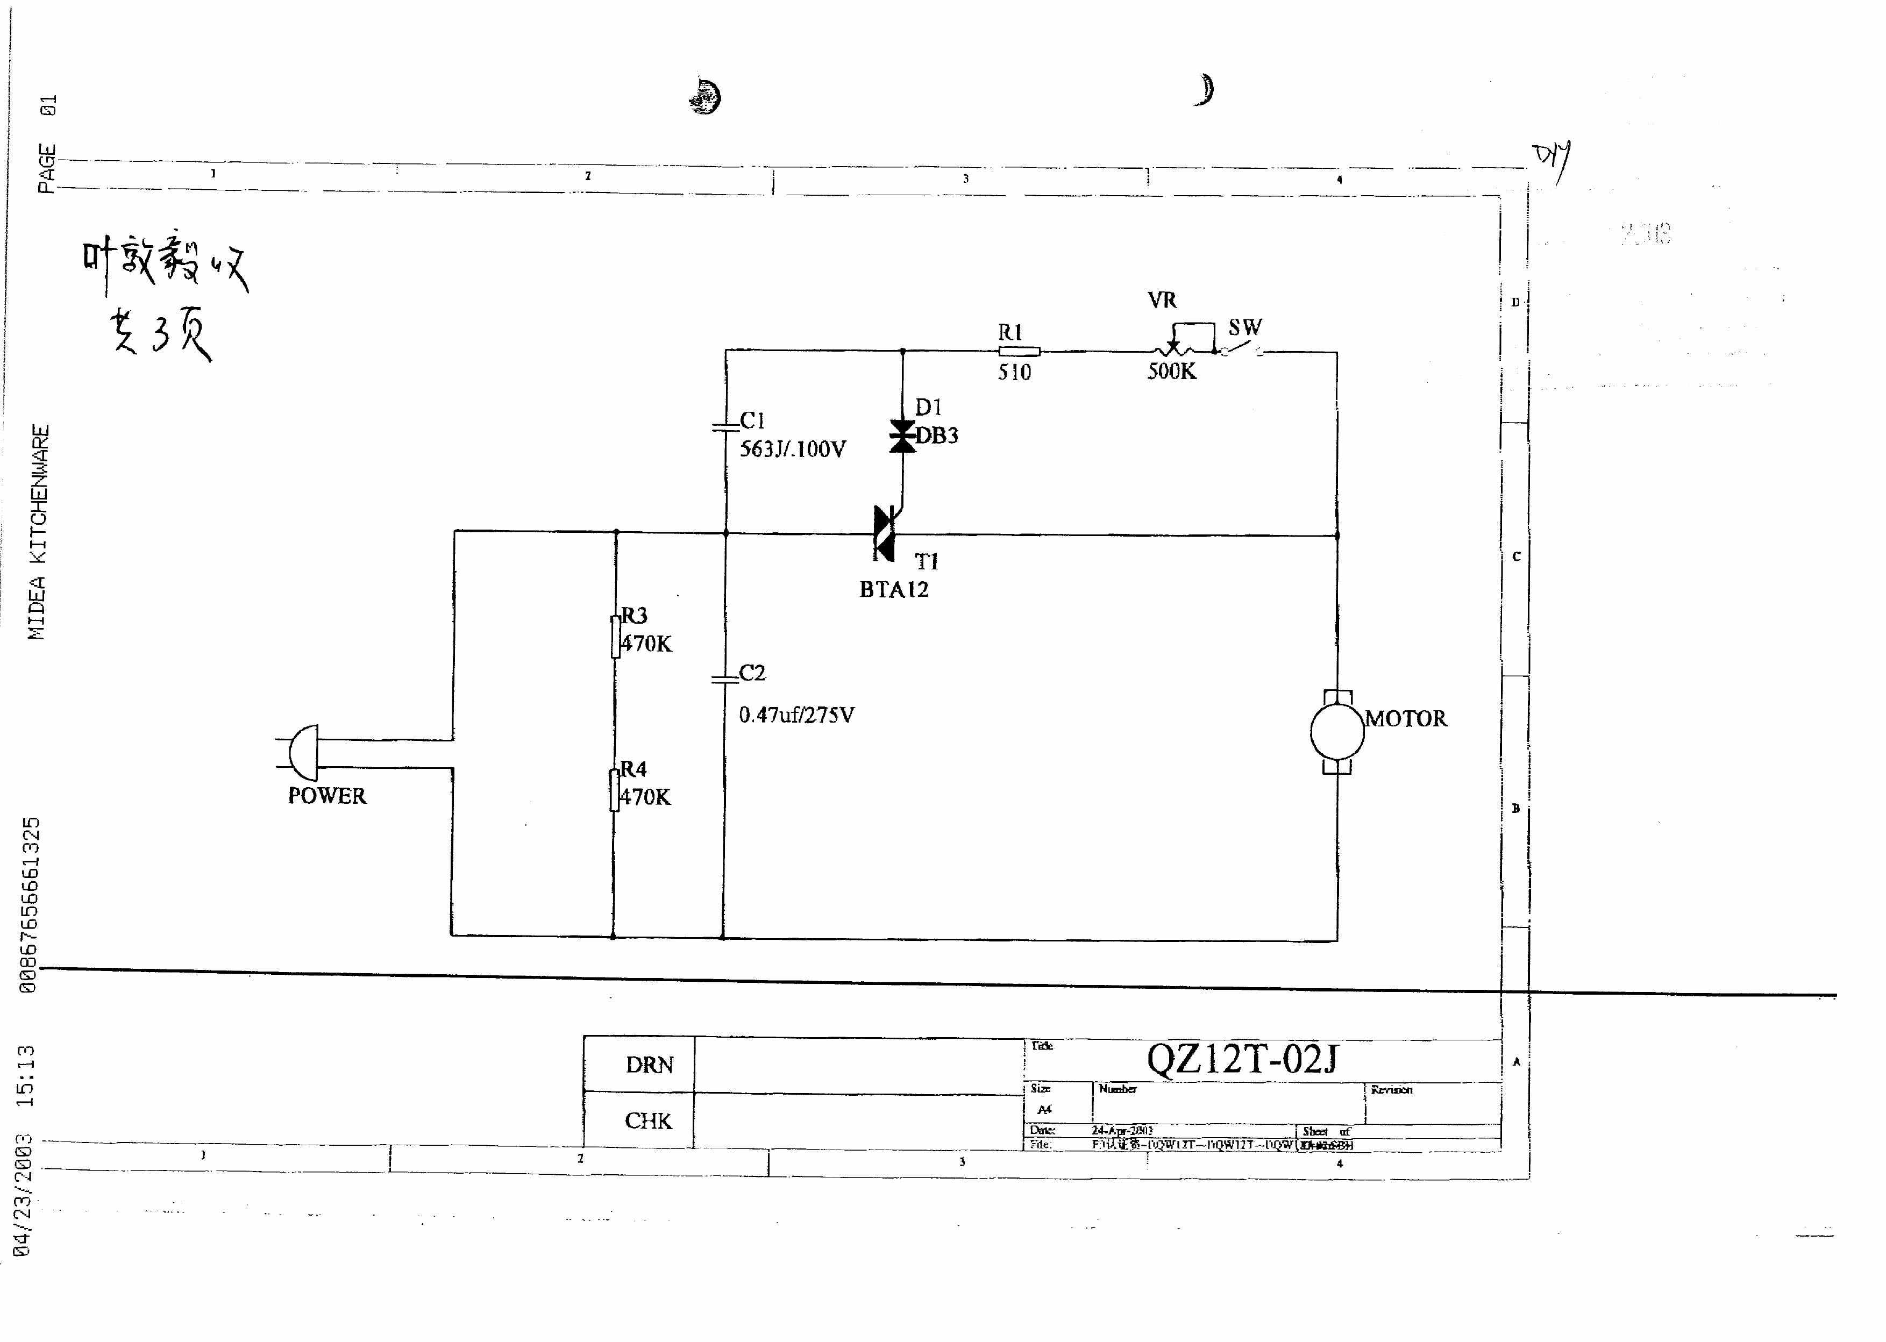

Slide 4
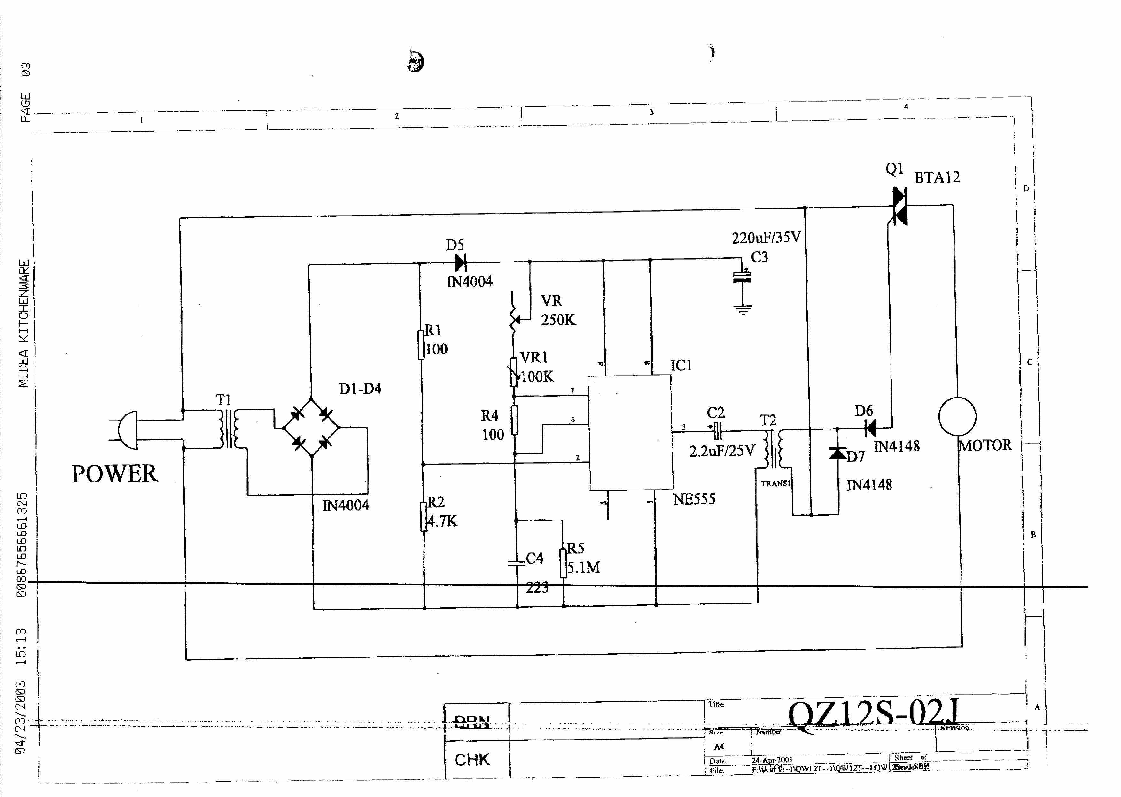

Slide 5
Disturbance Source

Slide 6
Sensitive components for immunity test

Slide 7

Applicable standards
EN 55014-1:2000+A1+A2
EN 55014-2:1997+A1
EN 61000-3-2:2000
EN 61000-3-3:1995+A1

Slide 8
Test items/operation modes
DV
DP
Click
Flicker
Harmonics
EMS for Household ( On )

Slide 9
Test items/operation modes
C/S
EFT
Surge
ESD
Voltage Dip

Slide 10
Thanks

